Slide 1
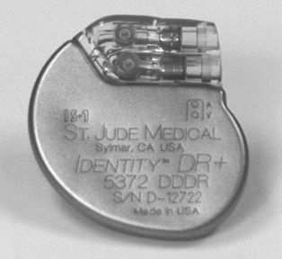
Pacemaker basics part 3 and troubleshooting
Dr Suresh S
Senior resident
Calicut

Slide 2
Pacemaker Tachycardia
Non-physiological tachycardia in which the pacemaker plays an essential role in initiating and sustaining the tachycardia.
I. Runaway pacemaker.
II. Sensor mediated tachycardia.
III. Pacemaker circus movement tachycardia.
IV. Timer related tachycardia.
V. Pacemaker synchronization to supraventricular tachycardia

Slide 3
Runaway pacemaker
pacemaker malfunction resulting in an inappropriately fast pacing rate (100 to 2100 ppm has been reported).
unpredictable, can be intermittent
represents a medical emergency with removal of the pulse generator
reports were published before 1980
two categories of runaway pacemakers

Slide 4
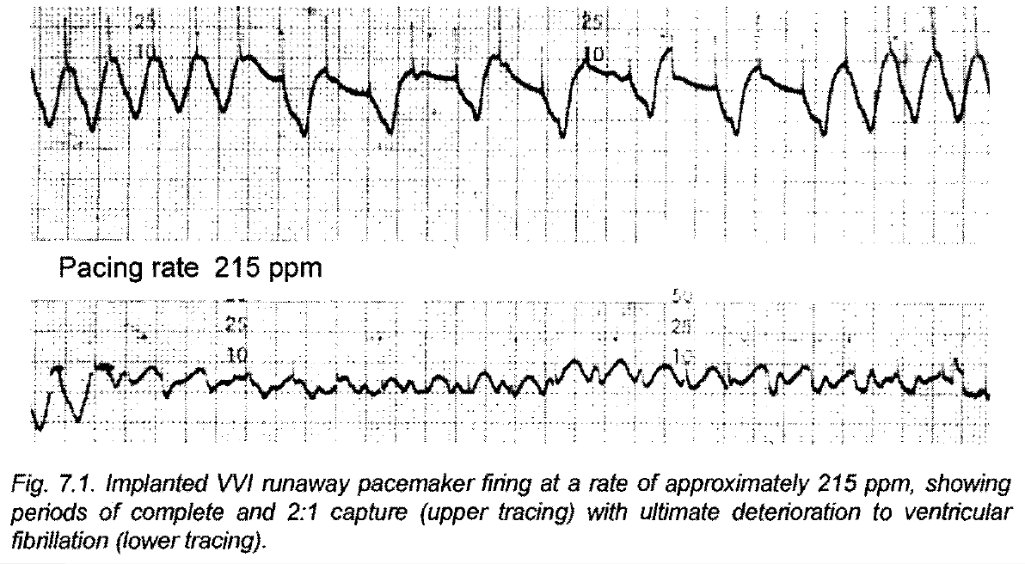

Slide 5
Spontaneous runaway pacemaker
reason for pacemaker runaway was battery depletion or the influx of body fluids into the electric circuitry.
This body fluid affected the electrical components resulting in changes in pacemaker timing thus allowing high pacing rates
Hermetically sealed pacemaker housing, preventing the penetration of body fluids and electrical protection circuits, has practically eliminated this problem.

Slide 6
Externally induced runaway pacemaker
following the use of electrocautery, application of a coil of a pacemaker analyzer,radiation therapy
All reported cases were irreversible
Incorporating runaway protection circuits.
A runaway protection rate of 140 ppm in single chamber.
The runaway protection rate in dual chamber systems varies from 180 to 200 ppm.

Slide 7
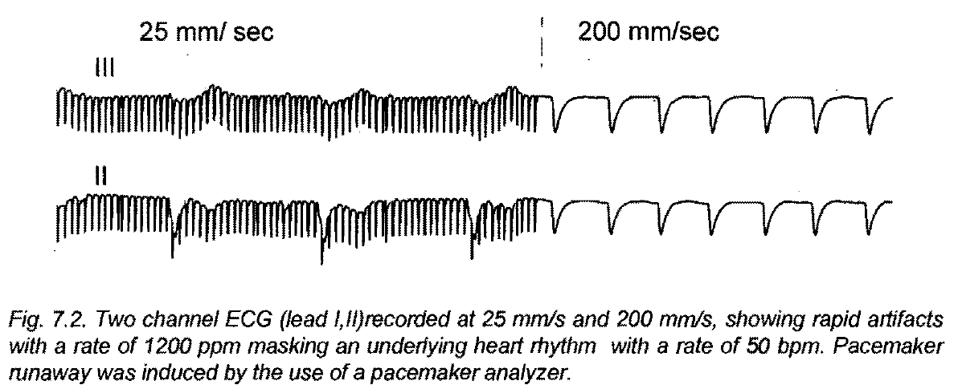
The mortality of runaway in unprotected pacemakers was 34% in a series of 44 case

Slide 8
Management of runaway pacemaker
A characteristic of pacemaker runaway is that magnet application does not affect the pacing rate.
Two reports describe successful inhibition of the implanted device by overdrive chest wall stimulation.
recommended therapy is immediate replacement or disconnection of the pulse generator

Slide 9
Sensor Mediated Tachycardia (SMT)
Tachycardia which is due to false triggering of the sensor, which subsequently gives rise to an inappropriate high pacing rate.
l. SMT induced by sensor detected "interference".
2. SMT induced by positive sensor feedback.

Slide 10
Sensor mediated tachycardia induced by interference
SMT induced by interference is caused by lack of specificity of the sensor to discriminate between interference from the appropriate sensor indicated changes.
When interference stops or is eliminated, normal pacemaker function is restored.
SMTs related to interference have been reported for activity, temperature and respiration sensors.

Slide 11
Sensor Mediated Tachycardia induced by positive feedback
a secondary reaction to the pacemaker stimulus (e.g. muscle twitching) is detected by the sensor thus increasing the pacing rate.
Pacing rate can rise to the programmed upper rate.
Positive feedback SMT is usually sustained but is easily terminated and prevented by reprogramming the pacing system.
SMTs due to a positive feedback mechanism have been described for activity, QT and temperature pacemakers.

Slide 12
Pacemaker Circus Movement Tachycardia (PCMT)
A pacemaker circus movement tachycardia (PCMT) is an artificial reentry tachycardia in which the retrograde limb of the circuit is provided by the atrioventricular (A-V) node or accessory pathway , while the anterograde limb is by way of synchronization of the pacemaker.
pacemaker mediated or endless loop tachycardias

Slide 13
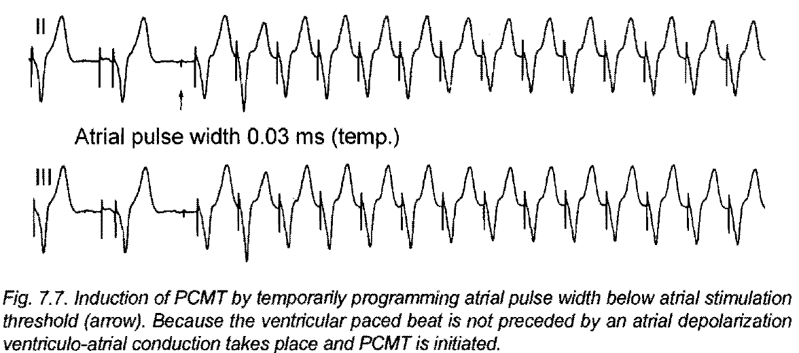

Slide 14
PCMT can occur in every pacing system with atrial synchronous ventricular stimulation possibilities (VAT, VDD, DDD), but clinical relevance became obvious with the introduction of DDD pacemakers with short non-programmable post ventricular atrial refractory periods.
A prerequisite for initiation of PCMT is ventriculo-atrial (VA) conduction, which is present in 68% of patients with normal A-V conduction and even in 44% of patients with abnormal A-V conduction

Slide 15
If stimulated ventricular depolarization is preceded by atrial depolarization, V-A conduction is not likely to occur, as the atrial activity will have depolarized part of the retrograde pathway, thereby causing refractoriness.
If however the atrial events and the paced ventricular events are sufficiently separated, so that the retrograde pathway is no longer refractory, V-A conduction and PCMT may result

Slide 16
circumstances
1. Ventricular premature beats
2. Atrial premature beats, which prolong A V interval significantly
3. Wenckebach upper rate behaviour
4. Artificial triggering in the atrial channel (e.g., myopotentials, chest wall stimulation magnet application)
5. Loss of capture in the atrial channel
6. Atrial undersensing
7. Rate smoothing
8. Fall back mode (in VVI mode)

Slide 17
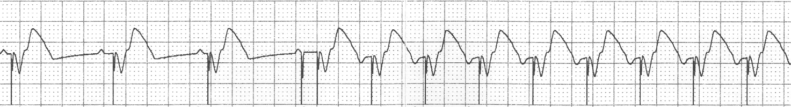
Consequence of Atrial Undersensing
Programming information:
  DDD 60–120 bpm
  PAC: 150 ms
  SAV: 120 ms
  PVARP: 310 ms
PMT (pacemaker mediated tachycardia) caused by atrial undersensing and retrograde conduction
The abrupt onset is one hallmark of PMT

Slide 18
Management of PCMT
Divided into preventing the onset of tachycardia or the termination of tachycardia.
Preventing the onset of PCMT is based on ignorance of the retrogradely conducted P wave.
A number of the programmable parameters can be used for prevention but they often are associated with a limitation of the upper rate behavior of the pacing system.
Termination is achieved by recognition of tachycardia followed by an interruption of atrial sensing for one cycle.
Several algorithms are developed for recognition of PCMT.

Slide 19
PMT Intervention
Designed to interrupt a Pacemaker-Mediated Tachycardia
DDD / 60 / 120

Slide 20
Post ventricular atrial refractory period (PVARP)
An effective way of preventing PCMT is by programming an appropriately long PVARP, thus ignoring the retrograde P-wave.
It will be clear that the length of PVARP, in order to give sufficient protection against PCMT, has to be longer than the VA conduction interval.
PCMTs with relatively short VA intervals are easily controlled by programming an appropriately long PV ARP without affecting the upper tracking rate adversely by induction of 2:1 A V block.

Slide 21
Long PV ARP required for a long VA conduction interval, will adversely affect the upper tracking rate.
The upper tracking rate is determined by the total atrial refractory period (T ARP), sum of PVARP and the programmed AV intervaL
If the P-P interval is shorter than TARP, every second P wave will not be sensed, resulting in 2:1 A V block.

Slide 22
Ventricular Premature Beats
Automatic extension of PV ARP after a ventricular premature beat (VPB) has made a major contribution to the prevention of PCMTs intiated by VPBs.
Initially some pacemakers reverted to DVI mode upon detection of a VPB.
However, PCMTs can still occasionally be initiated by the DVI mode after the VPB.
If the atrial stimulus of the temporary DVI mode occurs during the refractory period of the atrial tissue following a preceding sinus P wave, the ventricular paced event is now able to conduct retrogradely to the atrium.
A DDD escape mode after a VPB with an extended atrial refractory period is therefore a better option.

Slide 23
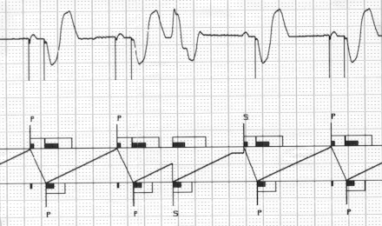
PVC Response
Designed to prevent sensing of retrograde P-waves, when they happen due to a PVC

Slide 24
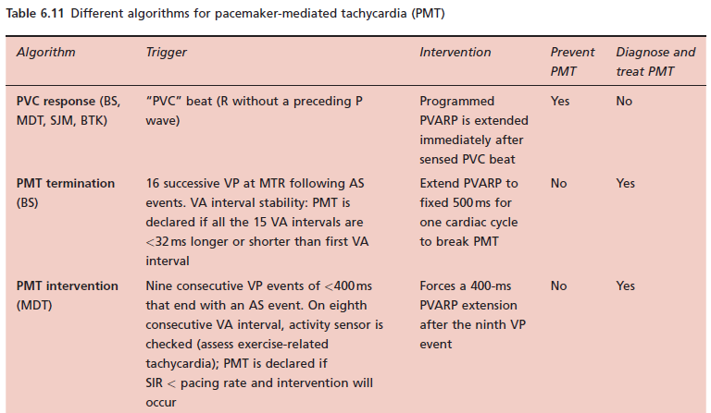

Slide 25
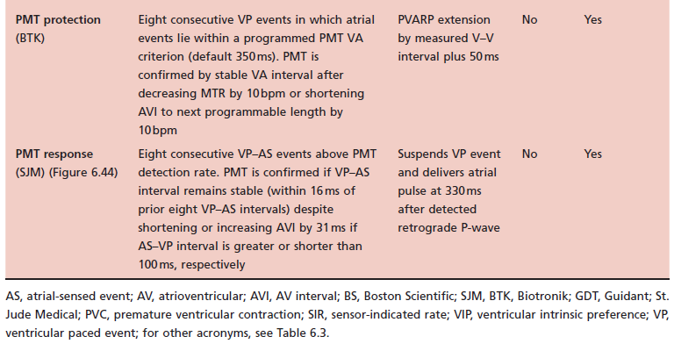

Slide 26
Pacemaker synchronization to supraventricular tachycardia.
Atrial tachyarrhythmias like atrial flutter/fibrillation (AF) preclude the use ofDDD pacing since the device synchronizes ventricular stimuli to the sensed atrial tachyarrhythmia.
The incidence of atrial fibrillation after implantation of a DDD pacemaker varies from 5.6 to 9.8% even in the absence of a previous history of atrial fibrillation.
Onset of atrial fibrillation afte implantation of a pacemaker which synchronizes ventricular stimuli to sensed atrial events may result in an inappropriate ventricular pacing response

Slide 27
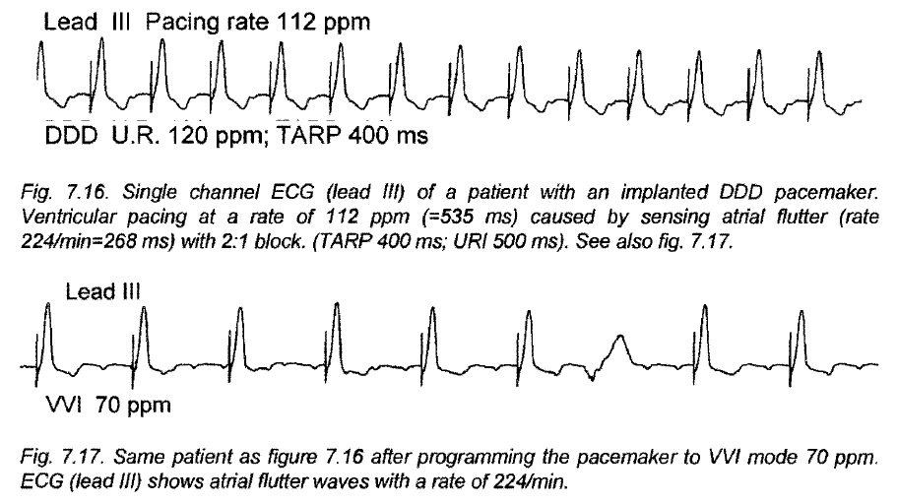

Slide 28
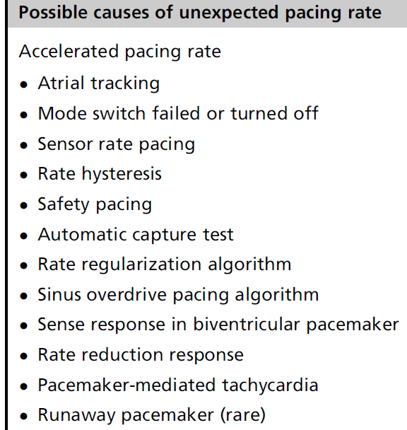
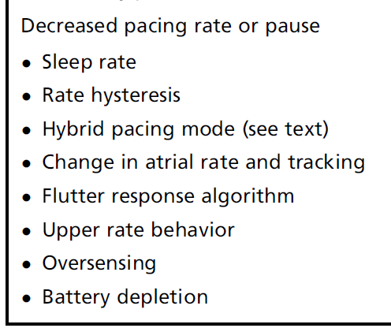

Slide 29
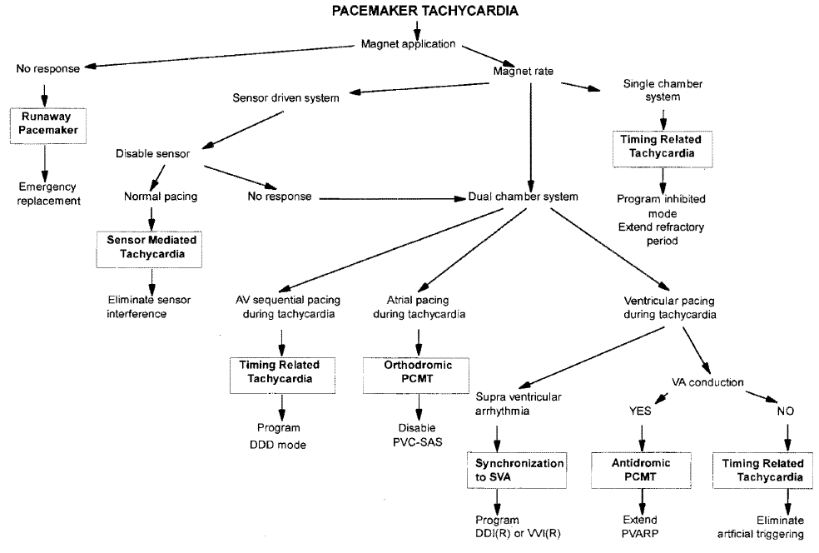

Slide 30
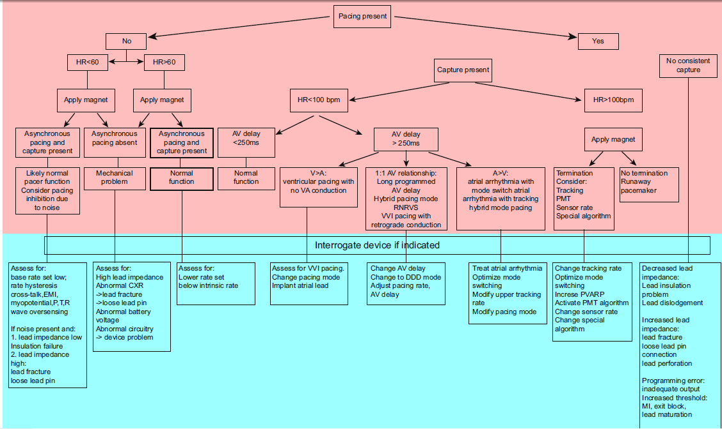

Slide 31
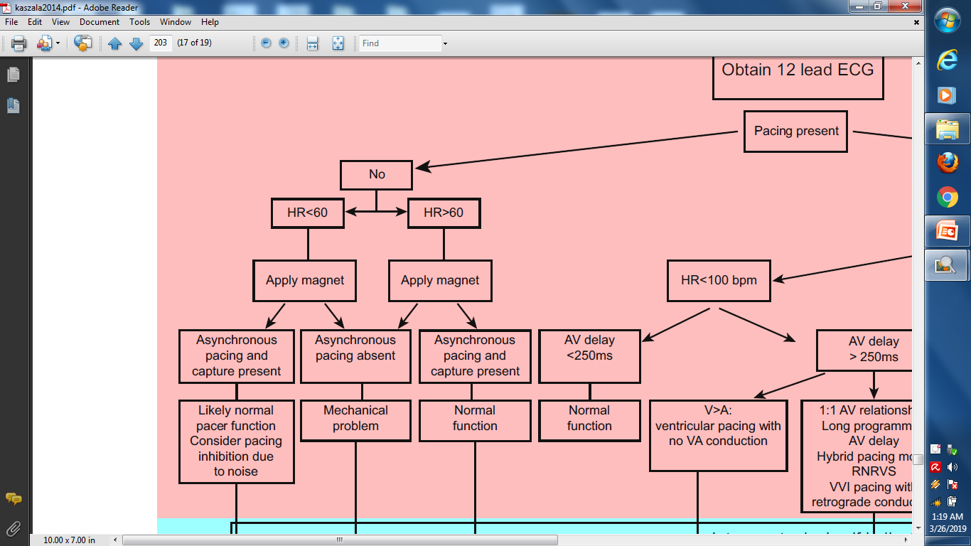
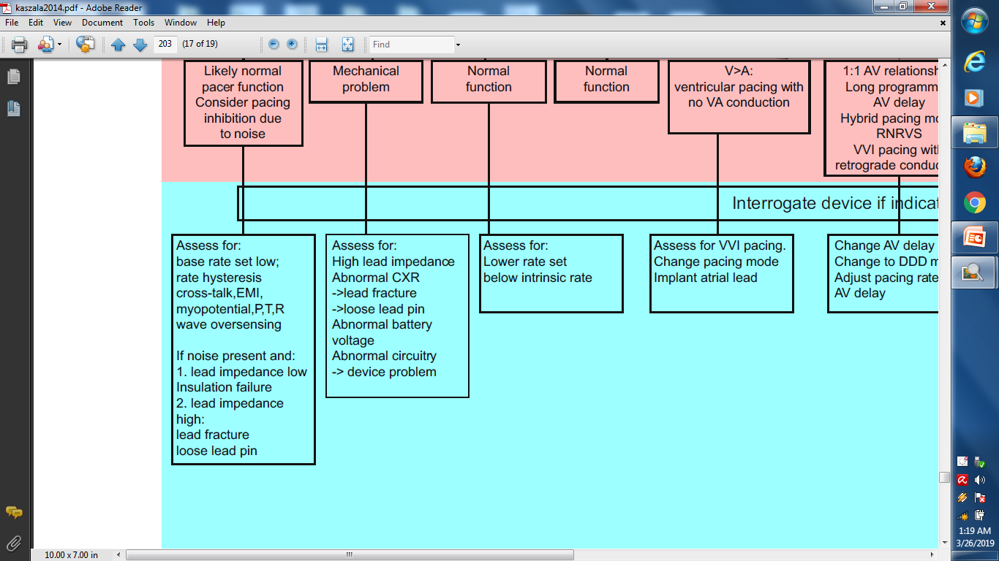

Slide 32
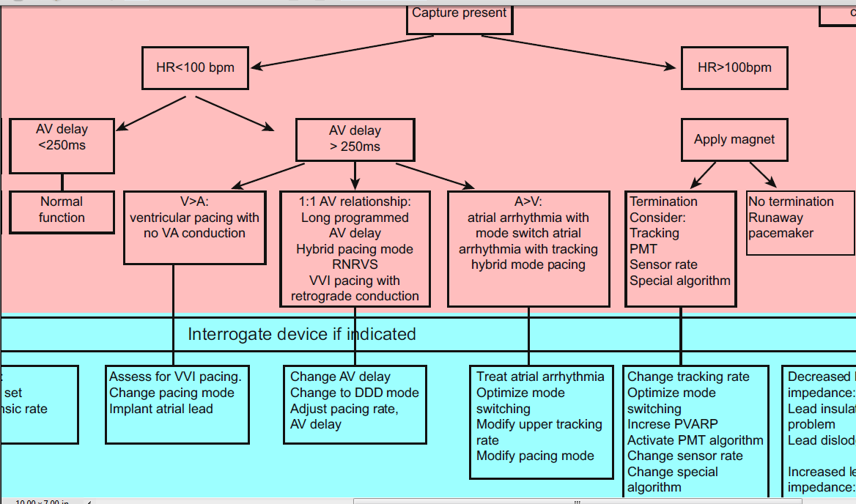

Slide 34
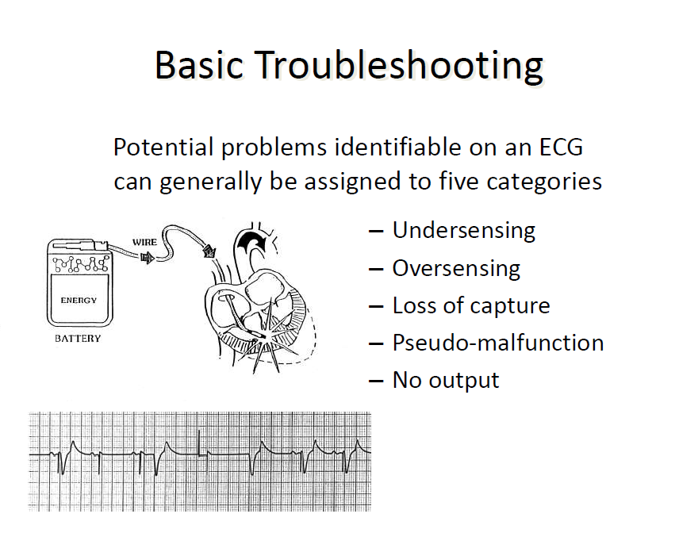

Slide 35
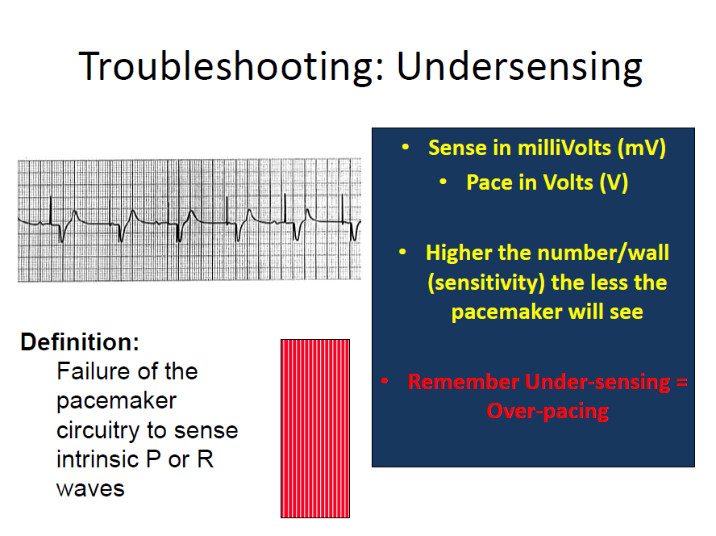

Slide 36
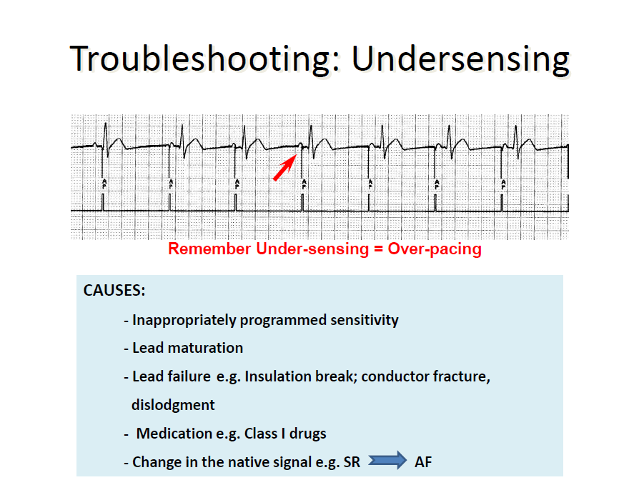

Slide 37
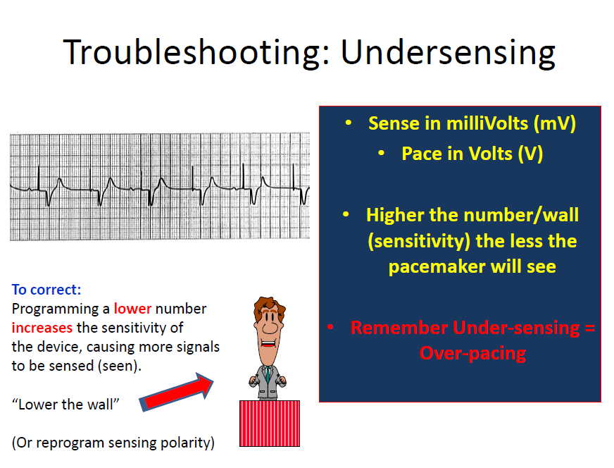

Slide 38
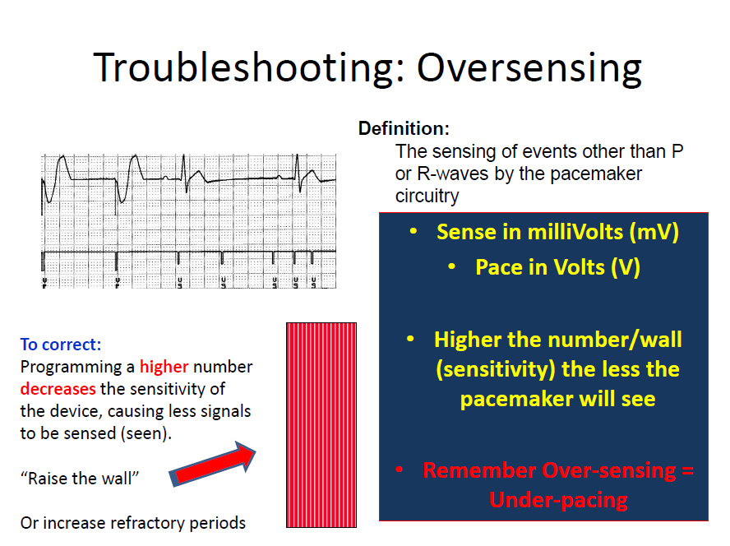

Slide 39
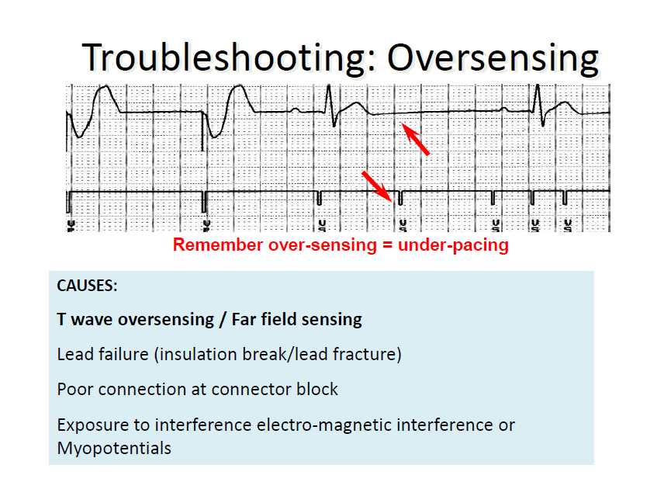

Slide 40
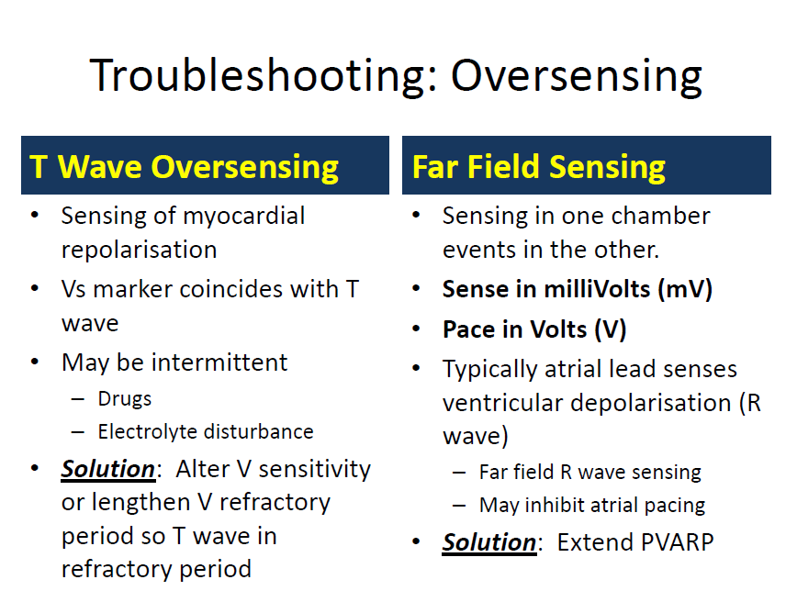

Slide 41
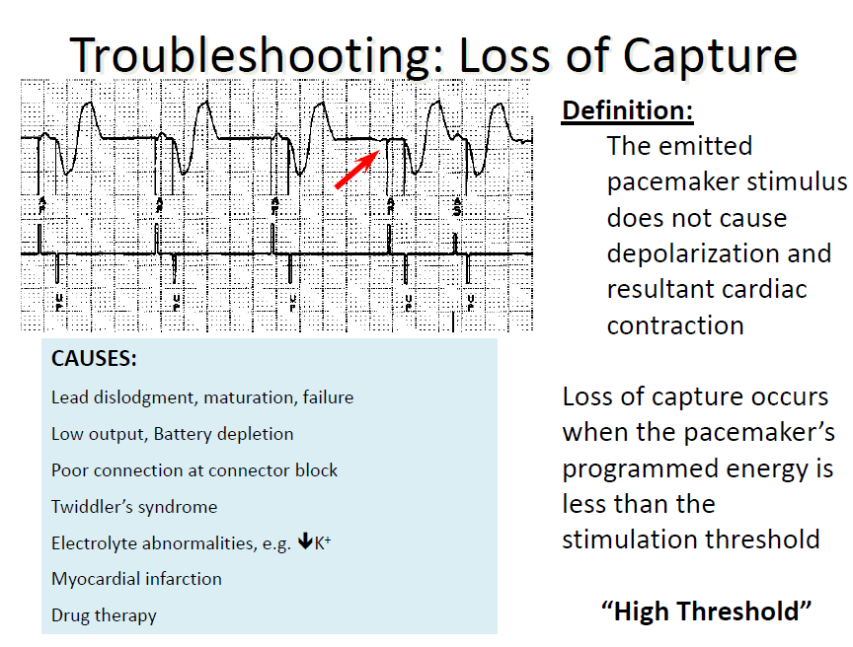

Slide 42
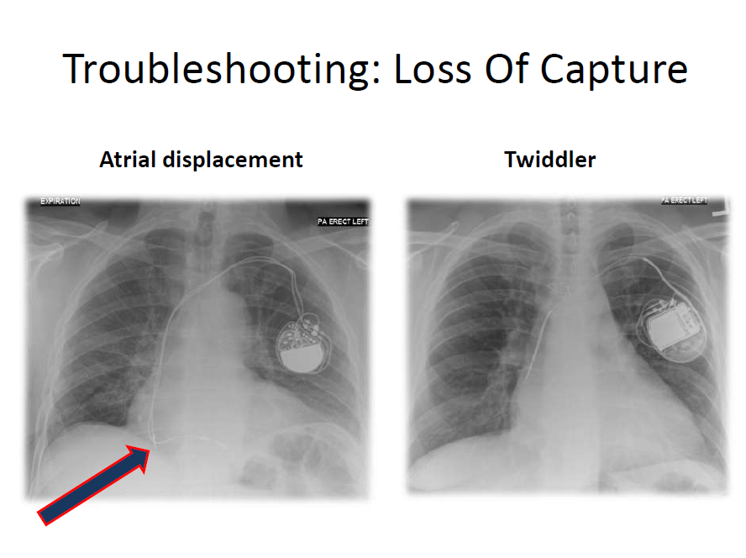

Slide 43
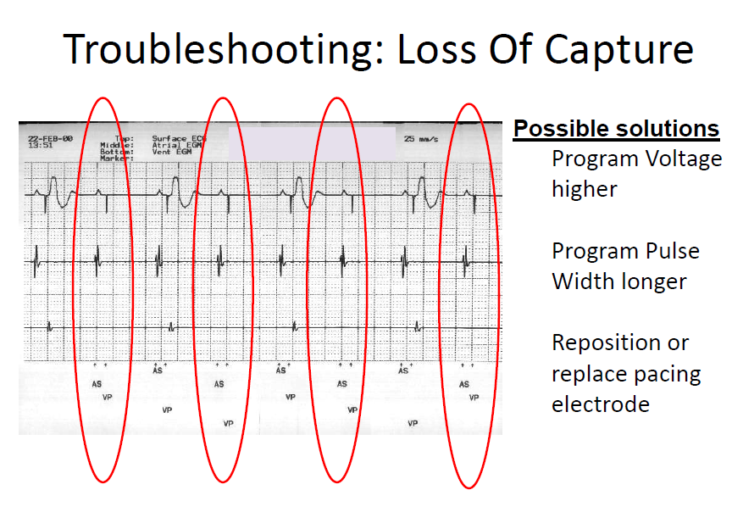

Slide 44
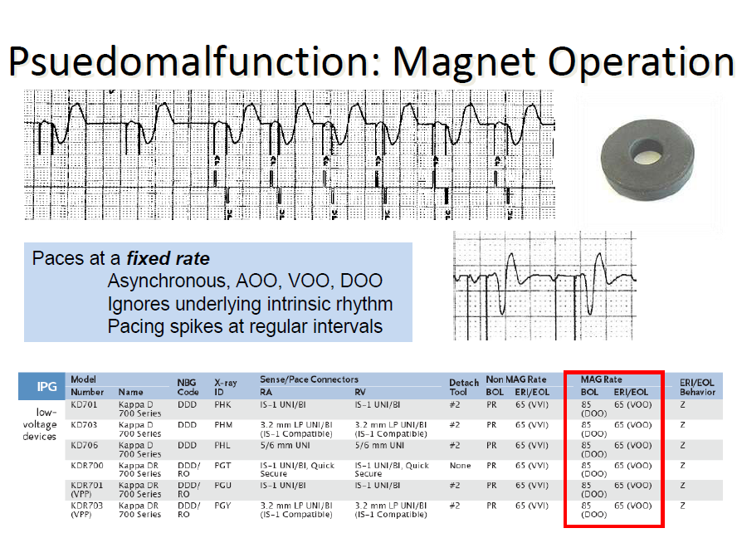

Slide 45
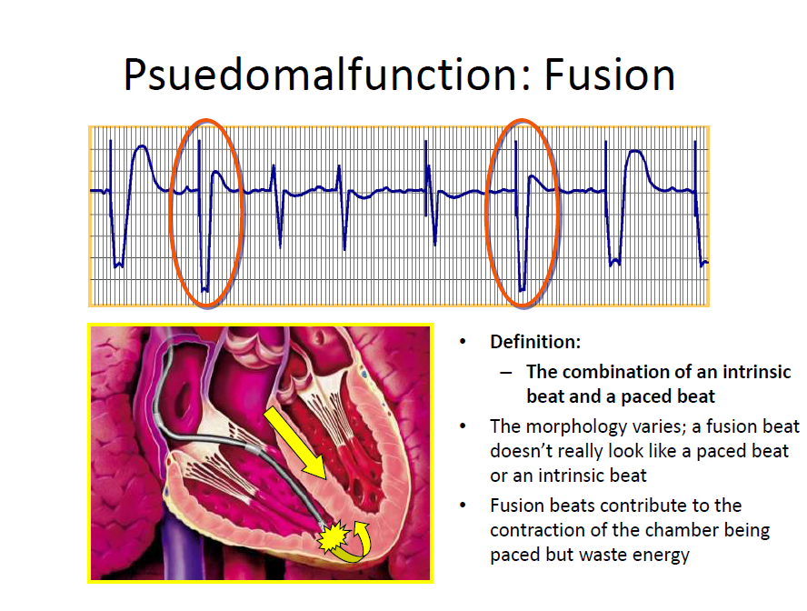

Slide 46
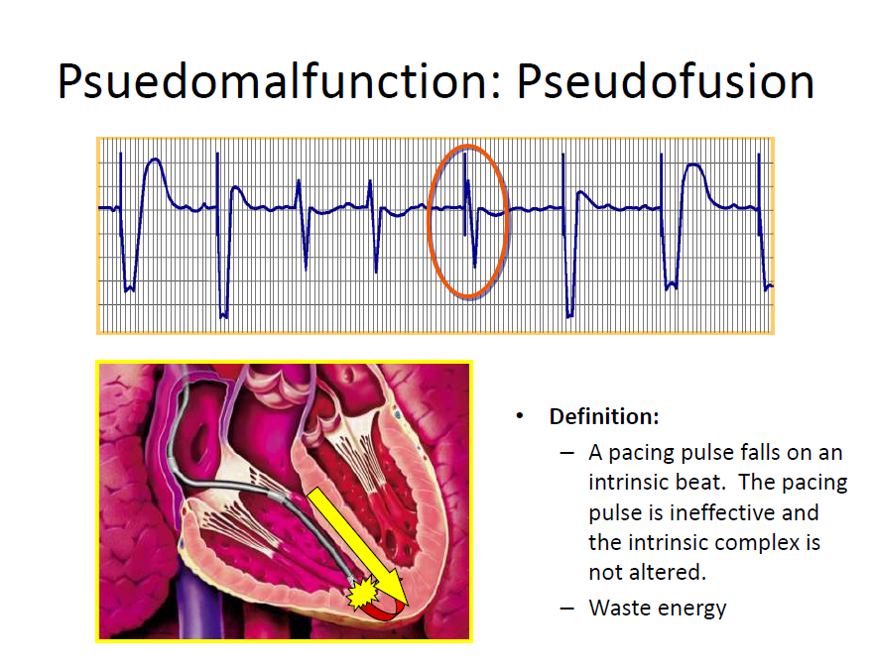

Slide 47

Troubleshooting Tools
Patient
Patient’s Chart
Patient registration card
Calipers
Magnet
12 Lead ECG
Technical Services
Pacing Encyclopedia
Product Performance Report
Company Device Technical Service
Programmed parameters
Patient symptoms
Medical history
Indication for implant
Implant date
Rhythm strip
Device model number
Lead model numbers
Telemetry data (Impedances, Battery voltage, Marker Channel™)
Device diagnostics
Device RRT and EOS behaviors

Slide 48
Magnet Mode
What happens when a magnet is applied over a pacemaker?
The pacemaker mode temporarily switches to VOO in single chamber devices and DOO in dual chamber devices.
  Asynchronous pacing delivers output regardless of intrinsic activity
  Pacing rate will be 85 bpm for pacemaker battery levels above ERI (elective replacement indicator) and 65 bpm for battery levels below ERI*
  When the magnet is removed, the previously programmed mode returns*
Use when:
  Checking pacemaker battery level
  EMI is present (surgery, TENS, etc.)
  Device troubleshooting (breaking a PMT, assessing capture, etc.)
*This operation is specific to Medtronic devices

Slide 49
Knowledge Checkpoint
Match the 4 troubleshooting steps with the corresponding action and put them in order:
Identify cause of problem(s)
  Form your hypothesis
Define the problem
  Test your “solution”
Verify the solution
  Make a suggestion
Correct the problem
  Observe/collect data
Notes:
Answer:
Define the problem
Observe/collect data
Identify the cause of the problem(s)
Form your hypothesis
Correct the problem
Test your “solution”
Verify the solution
Make a suggestion

Slide 50
4 Types of Troubleshooting Solutions
Observation / Pseudomalfunction
  Electrolyte imbalance
  Exposure to interference
Reprogramming
  Modes/Rates
  Outputs
  Sensitivity settings
  Features – On/Off
Repositioning the lead
  Lead Dislodgements
Replacing the lead or the pacemaker
  Battery Depletion / Circuit Failure
  Lead fractures
  Poor connection at connector block

Slide 51
PSEUDOMALFUNCTIONS

Slide 52
Pseudomalfunctions
ECG findings that appear to result from pacemaker malfunction but that represent normal pacemaker function
Defined as Unusual, Unexpected, Eccentric
May be classified under the following categories:
  Rate
  AV interval/refractory periods
  Mode

Slide 53
Pseudomalfunctions
Rate
Rate Changes May Occur Due to Normal Device Operation:
Magnet operation
Timing variations (A-A versus V-V timing)
Upper rate behavior (Pseudo-Wenckebach; 2:1 block)
Electrical reset (may occur due to exposure to electromagnetic interference (EMI) – e.g., electrocautery, defibrillation, causing reversion to a “back-up” mode)
Battery depletion
Device intervention algorithms (PMT, NCAP, PMOP, etc.)
Rate response
Therapy (Hysteresis, Rate drop response, Mode switching, MVP, etc.)

Slide 54
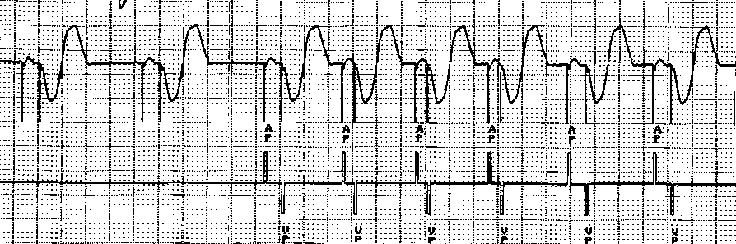
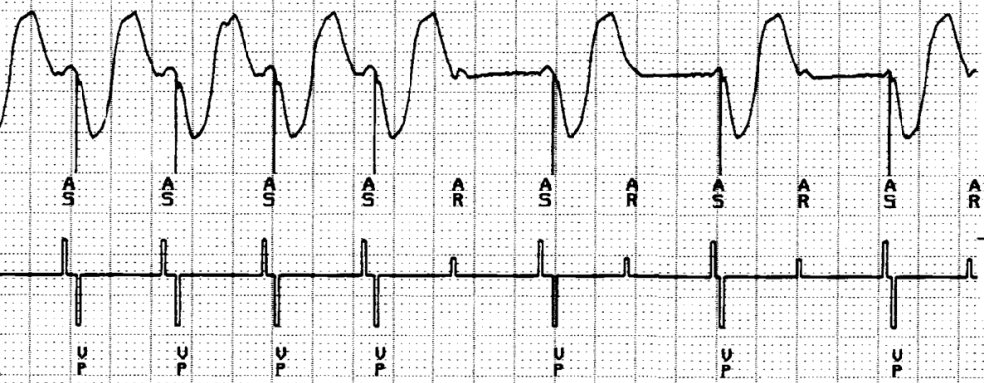
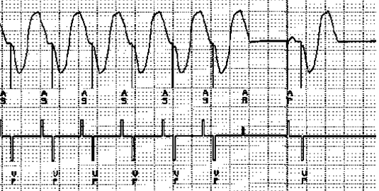
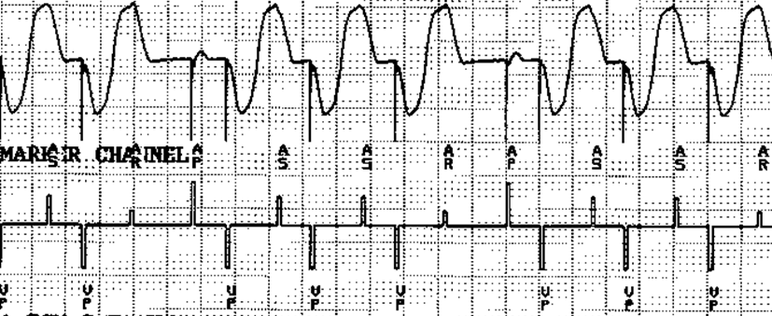
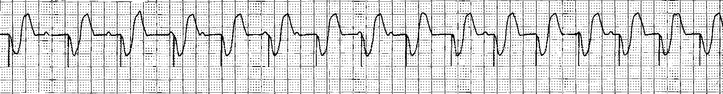
Pseudomalfunctions
Rate Examples
Magnet
2:1 Block Operation
Pseudo-Wenckeback Operation
PMT Intervention
Rate Response

Slide 55
Pseudomalfunctions:
AV Intervals/Refractory Periods
May appear anomalous due to:
  MVP Mode
  Safety pacing
  Blanking
  Rate-adaptive AV delay
  Sensor-varied PVARP
  PVC response
  Noncompetitive atrial pace (NCAP)

Slide 56
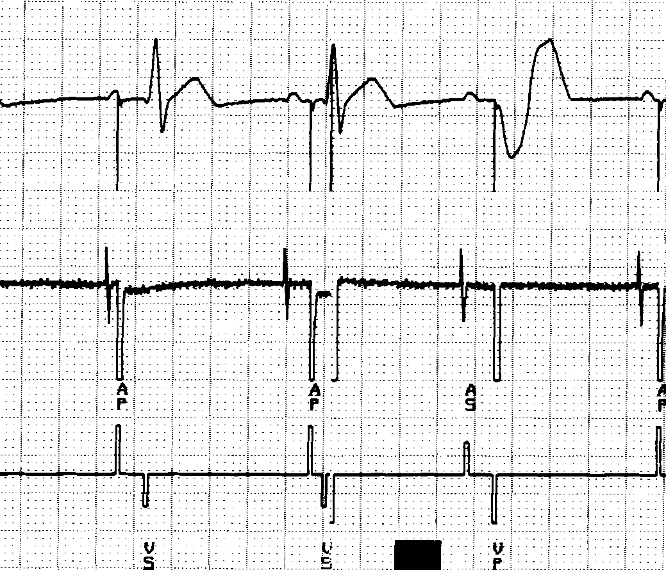
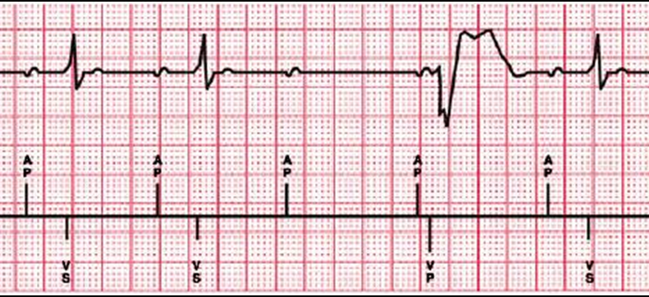
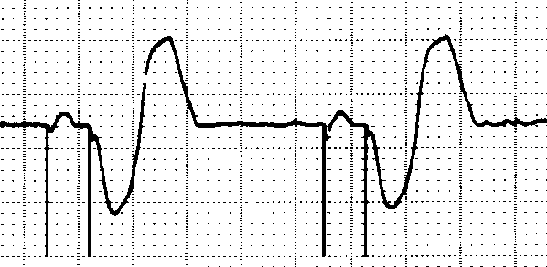
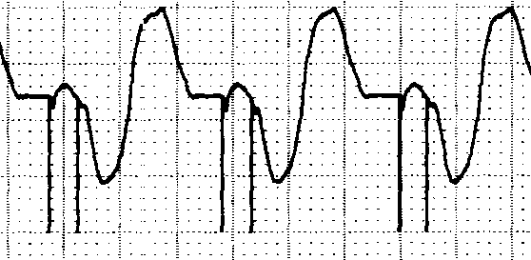
Pseudomalfunctions
AV Intervals/Refractory periods Examples
Ventricular Safety Pace
MVP Mode
Rate Adaptive AV Delay
PAV delay with no activity
PAV with activity

Slide 57
Pseudomalfunctions
Pacing Modes
May Be Caused By:
Battery depletion indicators (ERI/EOL)
Electrical reset
Mode switching
Noise reversion
  Sensing that occurs during atrial or ventricular refractory periods will restart the refractory period.
  Continuous refractory sensing is called noise reversion and will:
    Cause pacing to occur at sensor-indicated rate for rate-responsive modes
    Cause pacing to occur at the lower rate for non- rate-responsive modes

Slide 58
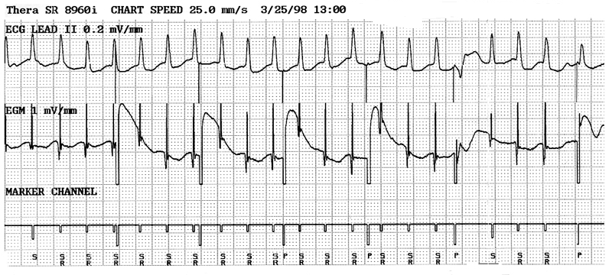
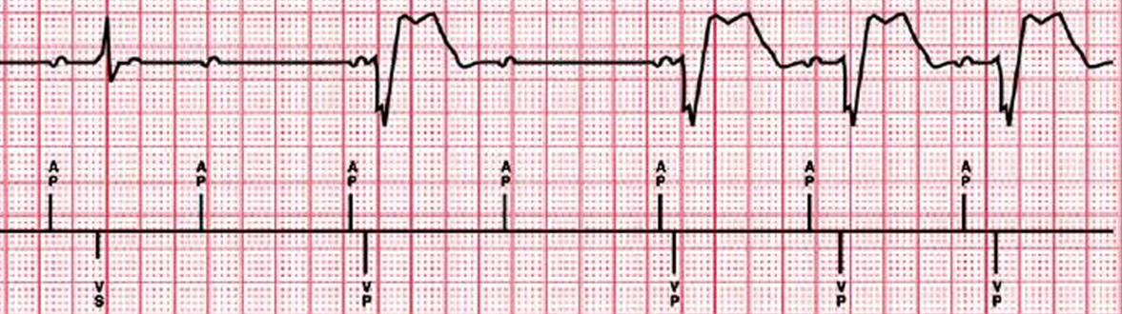
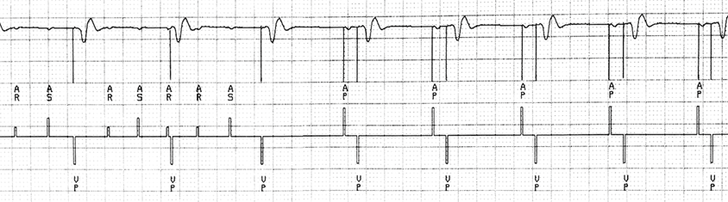
Pseudomalfunctions
Pacing Modes Examples
Noise Reversion
MVP Mode
Mode Switching

Slide 59
TROUBLESHOOTING CASE
Define the problem
Identify the cause of the problem(s)
Correct the problem
Verify the solution

Slide 60
Case 1
Information you have:
  DDD 60-130
  PAV/SAV 150-120 ms
  PVARP 310 ms
Question: Why is rhythm irregular, sometimes fast?
  Hypotheses:
    Tracking PAF
    Oversensing (tracking a “P-wave” that is not there)
    Are these grouped beats – upper tracking rate behavior?
Click for Hint

Slide 61
Case 1
First Hypothesis: Tracking Paroxysmal AF
What is the evidence for AF?
  Irregular ventricular events
  Could be “fine” AF, not visible on baseline
What is the evidence against AF?
  Some visible P-waves
  Evidence of atrial pacing

Slide 62
Case 1
Second Hypothesis: Atrial Oversensing
What is the evidence for atrial oversensing?
  Irregular ventricular tracking
  Evidence of ventricular tracking without visible P-waves
What is evidence against atrial oversensing?
  There may be P-waves “hidden” in some T-waves

Slide 63
Case 1
Third Hypothesis: Upper Rate Behavior
What is the evidence for Wenckebach?
  Some evidence of “grouped” beats
  Evidence of P-waves “hidden” in some T-waves
What is evidence against Wenckebach?
  The A-A intervals don’t march out
  Evidence of atrial pacing – no need if this is UTR behavior

Slide 64
Case 1
What Are Your Next Steps?
To form a better hypothesis:
  Interrogate pacemaker
  Observe ECG and Marker Channel strip
To test the hypothesis:
  Perform sensing test – observe rhythm/markers
  Check lead impedance for low impedance (insulation break), which often causes oversensing (< about 250 Ω)
    What is the normal impedance range (assume standard leads)?

Slide 65
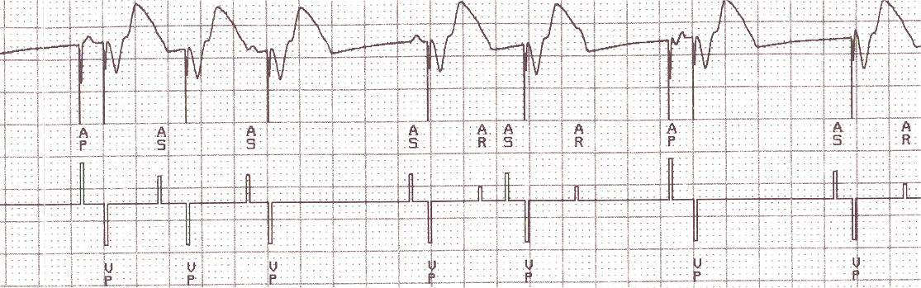
Case 1
Final Hypothesis: Atrial Oversensing
Confirmed by
  Marker Channel annotations showing AS markers without P-waves

Slide 66
Case 1
Conclusion: Atrial Oversensing
What do you consider?
    Ask questions
    Find out the relevant concerns about this patient
    If you are uncertain, call Technical Services
    Be ready to make an appropriate suggestion

Slide 67
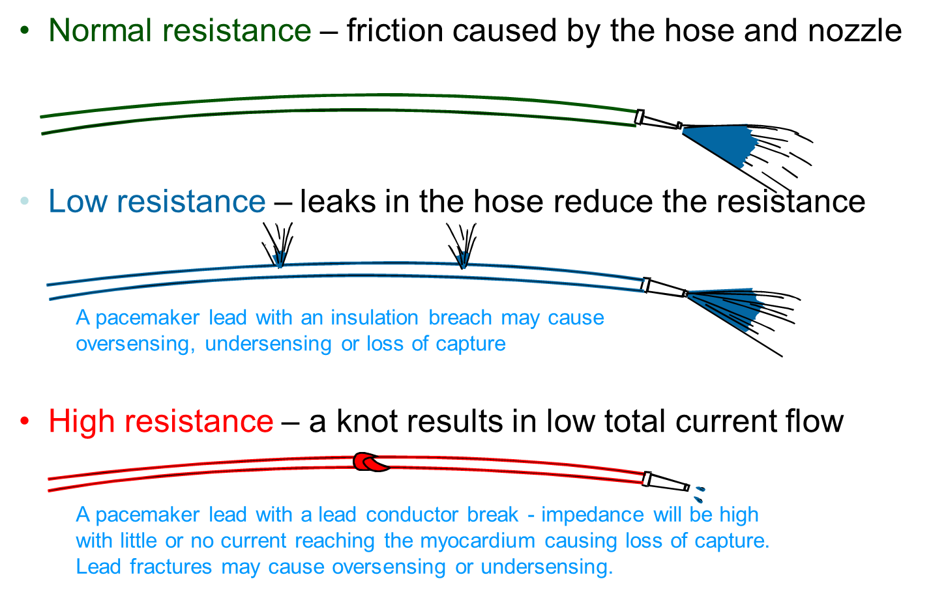
Case 1
Conclusion: Atrial Oversensing
Cause
  Insulation breach
  Bipolar impedance: 190 Ω

Slide 68
Case 1
Conclusion: Atrial Oversensing
Considerations:
  How easy is it to “fix”
    Unipolar lead in situ
  What are the risks to the patient to “fix”
    Elderly, debilitated patient
  What are the risks/implications if it is not “fixed”
    Loss of AV synchrony
    Possible that AF diagnostics are not accurate
    Risk of PMT
  Are there any alternatives?
    VVI?

Slide 69
Knowledge Checkpoint #1
Undersensing
Oversensing
Loss of Capture
Loss of Output
Normal
Notes:
Answer: A. Undersensing

Slide 70
Answer #1
Undersensing
Oversensing
Loss of Capture
Loss of Output
Normal
Undersensing may be caused by:
  Inappropriately programmed sensitivity
  Lead dislodgment
  Lead failure (Insulation break; conductor fracture)
  Lead maturation
  Medications, myocardial infarction, electrolyte imbalance

Slide 71
Knowledge Checkpoint #2
Undersensing
Oversensing
Loss of Capture
Loss of Output
Normal
Notes:
Answer: B. Oversensing

Slide 72
Answer #2
Undersensing
Oversensing
Loss of Capture
Loss of Output
Normal
Oversensing may be caused by:
Lead failure
Poor connection at connector block
Exposure to interference

Slide 73
Knowledge Checkpoint #3
Undersensing
Oversensing
Loss of Capture
Loss of Output
Normal
Notes:
Answer: C. Loss of capture

Slide 74
Answer #3
Undersensing
Oversensing
Loss of Capture
Loss of Output
Normal
Loss of capture may be caused by:
Lead dislodgment
Low output
Lead maturation
Poor connection at connector block
Lead failure

Slide 75
Knowledge Checkpoint #4
Undersensing
Oversensing
Loss of Capture
Loss of Output
Normal
Notes:
Answer: D. Loss of Output

Slide 76
Answer #4
Undersensing
Oversensing
Loss of Capture
Loss of Output
Normal
No output may be caused by:
Poor connection at connector block
Lead failure
Battery depletion
Circuit failure

Slide 77
Knowledge Checkpoint #5
Undersensing
Oversensing
Loss of Capture
Loss of Output
Normal
Notes:
Answer: E. Normal

Slide 78
Answer #5
Undersensing
Oversensing
Loss of Capture
Loss of Output
Normal
Appropriate rate change due to magnet application
Causes asynchronous pacing at a designated “magnet” rate
Most Medtronic pacemakers
  85 bpm – battery OK
  65 bpm – elective replacement

Slide 79
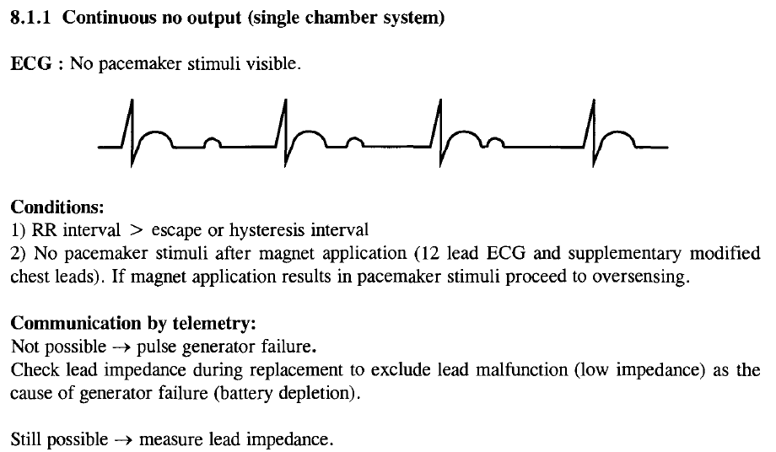

Slide 80
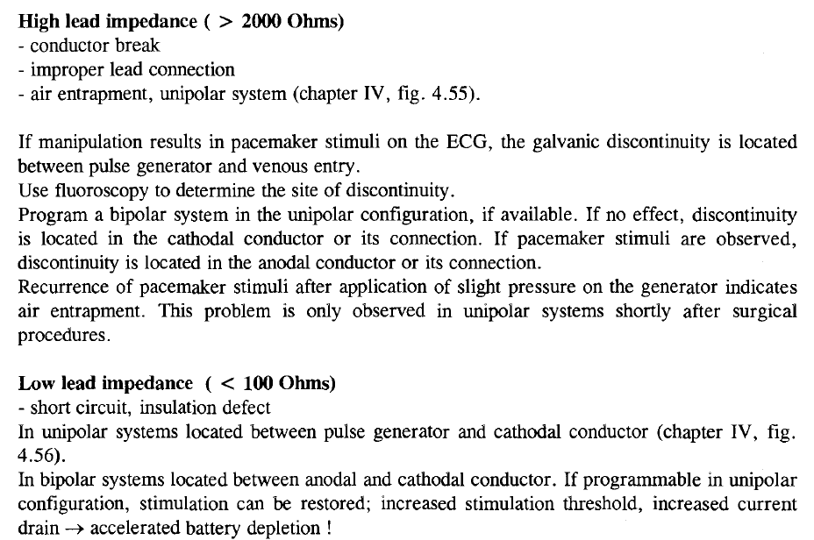

Slide 81
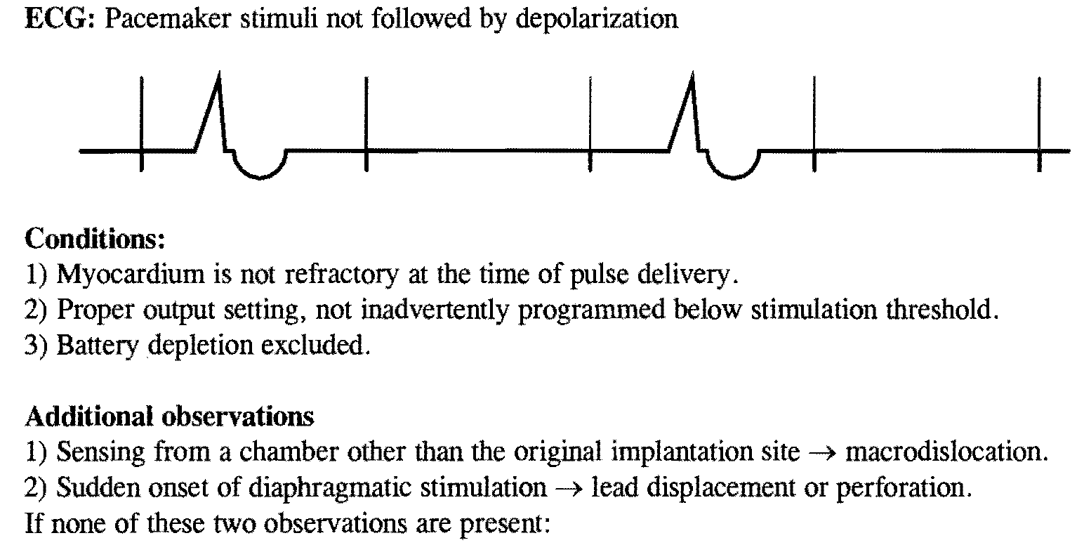

Slide 82
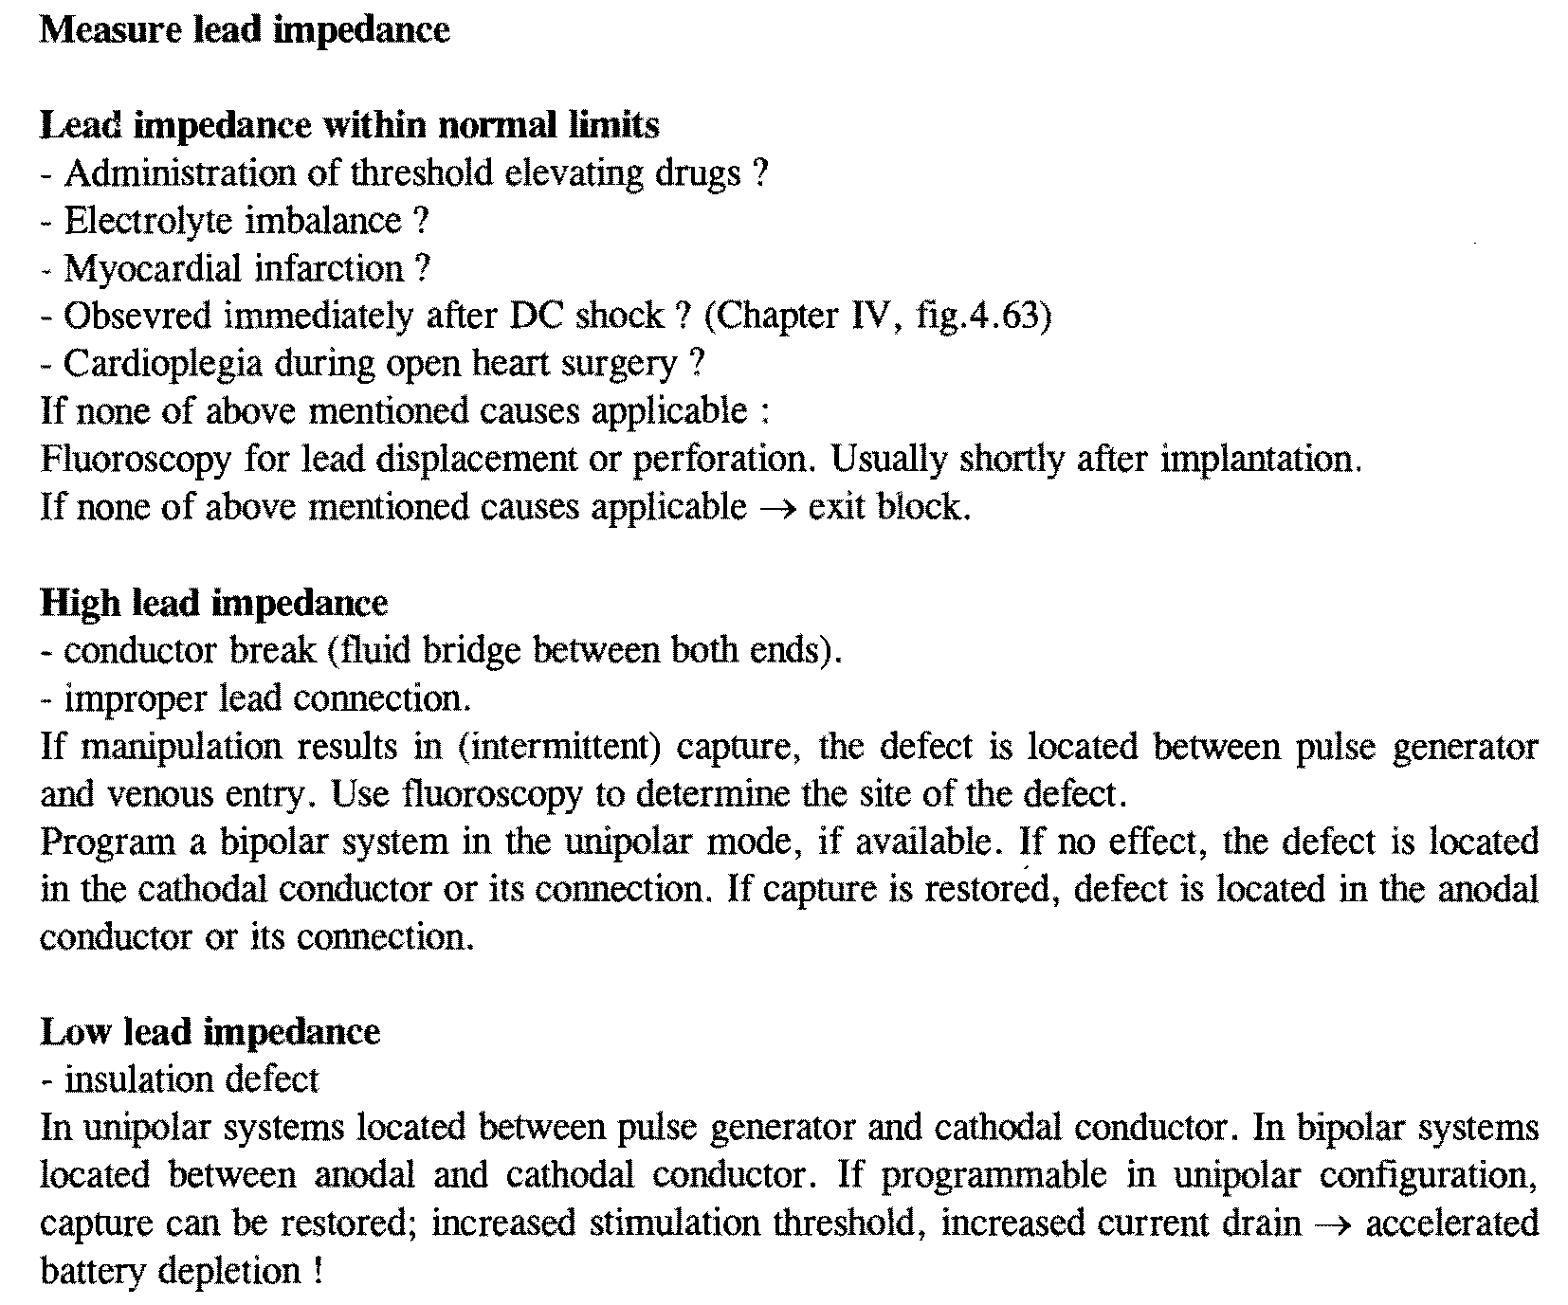

Slide 83
Programing

Slide 84
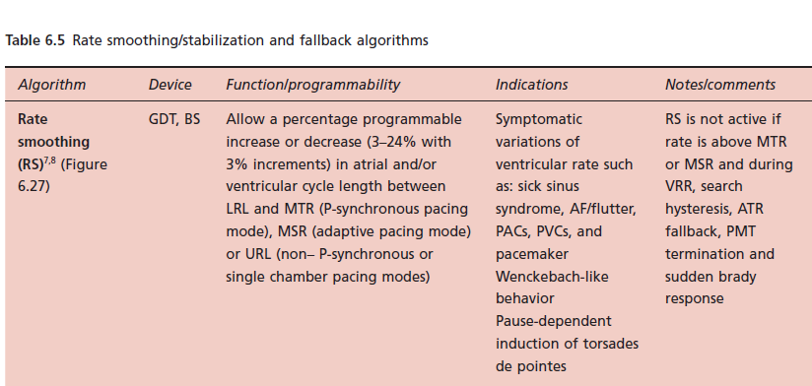

Slide 85
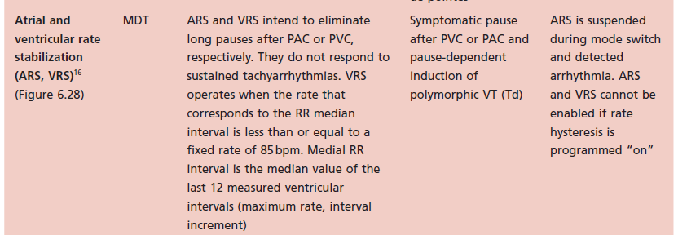

Slide 86
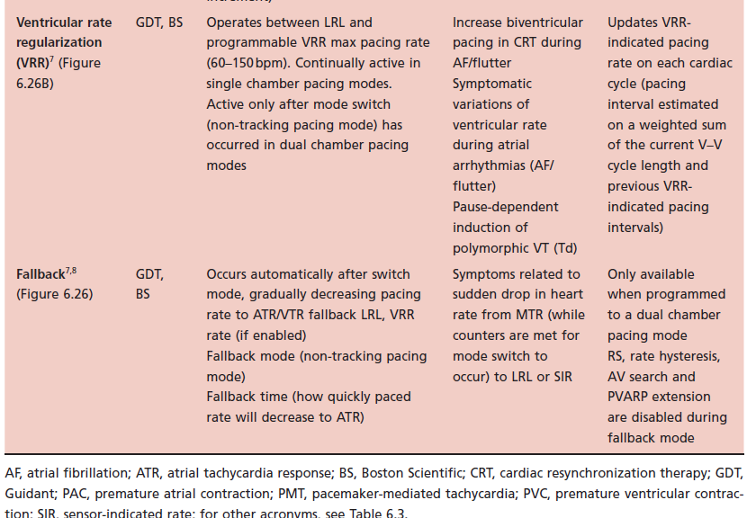

Slide 87


Slide 88


Slide 89


Slide 90


Slide 91


Slide 92


Slide 93


Slide 94


Slide 96


Slide 98
Thank you

